Slide 1

Credit Card Fraud Detection
Presented By:
Anjuna
Nayana
Bisna Abbas
Faiza Khan
Smita

Slide 2
Problem Statement
The problem is to investigate the credit card frauds increasing day by day , due to increasing online transactions and a better technology there comes pros as well as cons .so here we have analyze the credit card transaction dataset for detecting fraud by using decision tree method.

Slide 3
Literature Review
- Fraudulent Detection in Credit Card System Using Random forest&Decision Tree:
With growing advancement in the electronic commerce field, fraud is spreading all over the world, causing major financial losses. In the current scenario, Major cause of financial losses is credit card fraud; it not only affects tradesperson but also individual clients. Decision tree, Genetic algorithm, Metalearning strategy, neural network, HMM are the presented methods used to detect credit card frauds. In contemplating system for fraudulent detection, artificial intelligence concept of Random forest & decision tree is being used to solve the problem. Thus by the implementation of this hybrid approach, financial losses can be reduced to greater extent.

Slide 4
Proposed Scheme
In proposed System, we are applying Random forest algorithm and Decision tree classifier for classification of the credit card dataset. Random Forest is an algorithm for classification and regression. . The Random Forest algorithm has been found to provide a good estimate of the generalization error and to be resistant to over fitting .Summarily,it is a collection of Decision tree classifiers.
We propose a Machine learning model to detect fraudulent credit card activities in online financial transactions. Analysing fake transactions manually is impracticable due to vast amounts of data and its complexity. However, adequately given informative features, could make it is possible using Machine Learning.

Slide 5
Overview Of The System
Test Data
Dataset
Pre-processing
Feature Extraction
Machine Learning Model
Performance Analysis
Result
Classifier Section

Slide 6
Data Collection
The Dataset contains two-days credit card transactions made in September 2013 by European cardholders. The dataset is highly unbalanced with a low percentage of fraudulent transactions within several records of normal transactions. The positive class (frauds) account for 0.172% (492 frauds out of 284,807 transactions) of all transactions. Features V1, V2, ... V28 are the principal components obtained with PCA, the only features which have not been transformed with PCA are 'Time' and 'Amount'. Feature 'Time' contains the seconds elapsed between each transaction and the first transaction in the dataset. Feature 'Class' is the target variable with value 1 in case of fraud and 0 otherwise.

Slide 7
Data Preprocessing
Pre-processing is the process of important and common steps as follows:
1. Formatting: It is the process of putting the data in a legitimate way that it would be suitable to work with. Format of the data files should be formatted according to the need. Most recommended format is .csv files.
2. Cleaning: Data cleaning is a very important procedure in the path of data science as it constitutes the major part of the work. It includes removing missing data and complexity with naming category and so on. There may be data instances that are incomplete and do not carry the data you believe you need to address the problem. For most of the data scientists, Data Cleaning continues of 80% of work.
3. Sampling: The dataset is unbalanced. Training unbalanced dataset with learning algorithms may lead to misclassification of minority class. Therefore, to compensate for the unbalanceness, we continuosly checked the tain and test data.
4. Scaling: It is a step of data Pre Processing which is applied to independent variables or features of data. It basically helps to normalise the data within a particular range. Sometimes, it also helps in speeding up the calculations in an algorithm. It scales the data to have zero mean and unit variance. Standard Scaler is used that standardises the data.

Slide 8
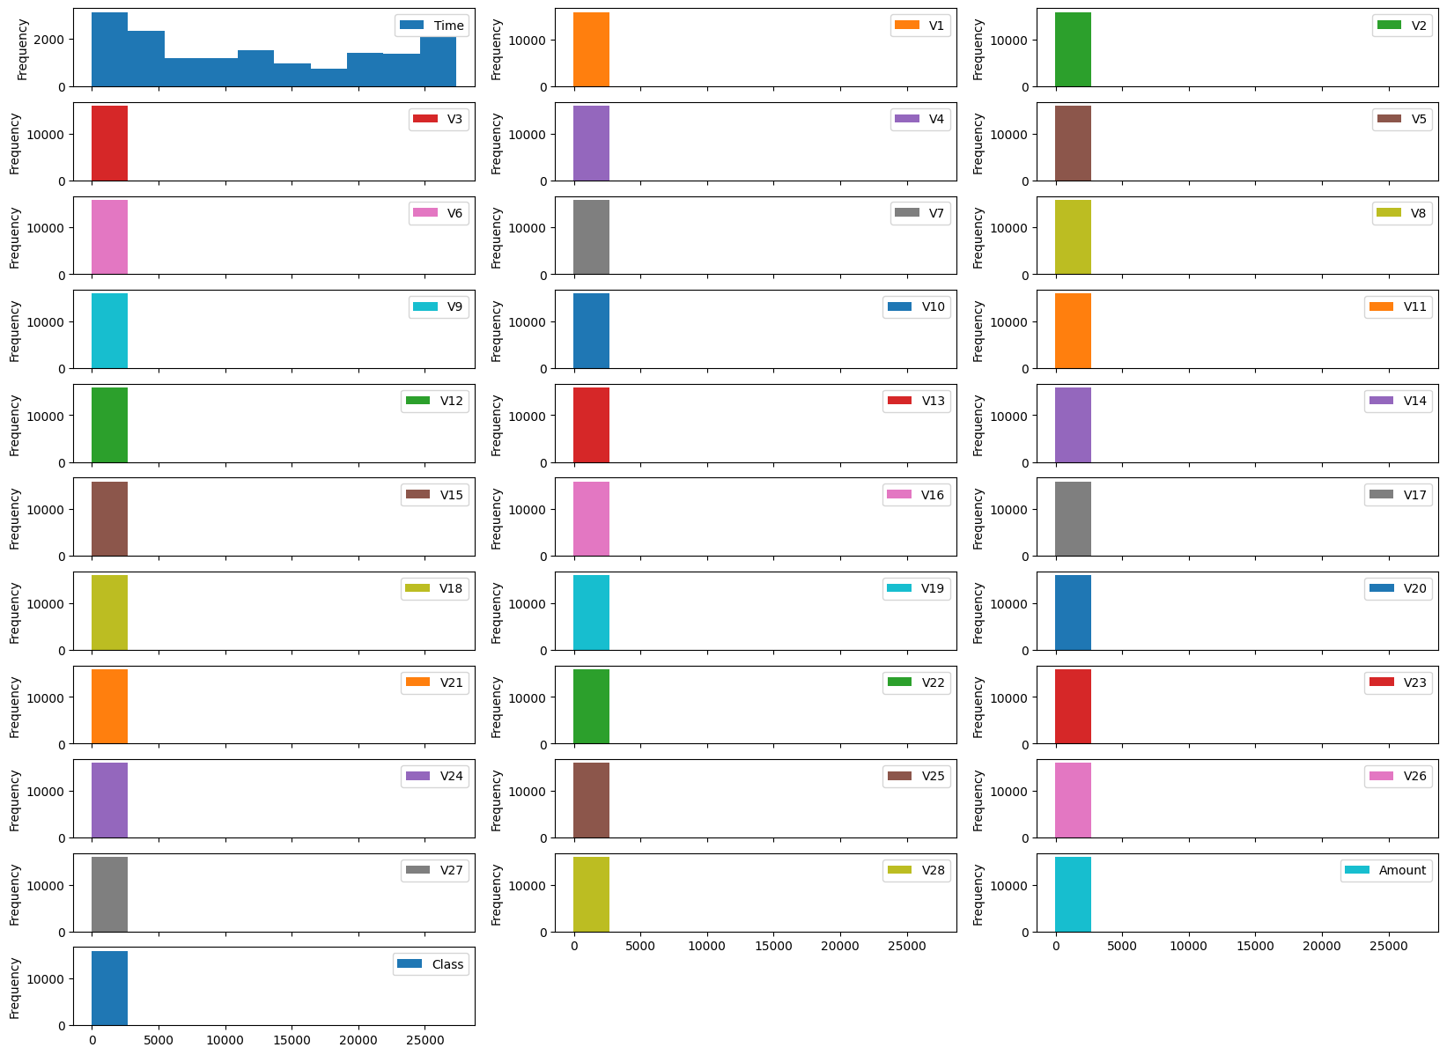
Result​
Histogram of each features:

Slide 9
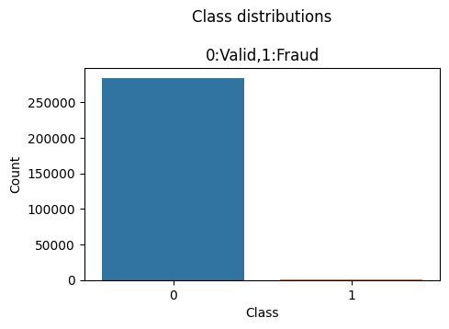
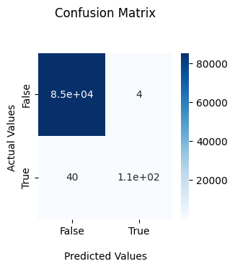
Analysis of Valid and Fraud Transactions:

Slide 10
Conclusion
In this paper we have used Classification algorithms to detect the credit card frauds of real dataset that contains two-days credit card transactions made in September 2013 by European cardholders. The dataset is highly unbalanced with a low percentage of fraudulent transactions within several records of normal transactions .we have used classification algorithams to detect the credit card frauds.
This dataset is used to train and test different classification models which include Random Forest and Decision tree. In order to evaluate performance of each model we have used Classification Report . Hence, we have acquired the result of an accurate value of credit card fraud detection i.e. 100.0% using a random forest and Decision tree algoritham.
It is important to note that fraudesters are constantly evolving their tactics ,so it's essential to monitor and update the fraud detection system regularly .Machine learning models should be continuosly retrained and updated with new data to improve their accuracy and performance

Slide 11

Thank you

